Slide 1
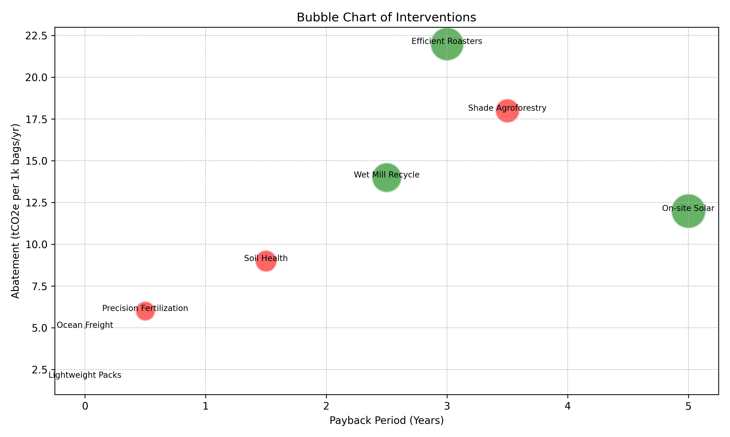
Interventions and ROI
Shade agroforestry: Capex $350/ha, Payback: 3-4 yrs, Abatement: 18 tCO2e, Benefits: Heat resilience, Biodiversity
Soil health: Capex $120/ha/yr, Payback: 1-2 yrs, Abatement: 9 tCO2e, Benefits: Yield +8%
Precision fertilization: Capex $50/ha, Payback: <1 yr, Abatement: 6 tCO2e, Benefits: Input savings 15%
Wet mill water recycle: Capex $7k/co-op, Payback: 2-3 yrs, Abatement: 14 tCO2e, Benefits: Effluent control
Efficient roasters: Capex $70k/plant, Payback: ≈3 yrs, Abatement: 22 tCO2e, Benefits: Quality consistency
On-site solar: Capex $150k, Payback: 4-6 yrs, Abatement: 12 tCO2e, Benefits: Energy cost hedge
Lightweight packs: Capex $0.05/bag, Payback: Immediate, Abatement: 2 tCO2e, Benefits: Lower material use
Ocean freight optimization: Payback: Immediate, Abatement: 5 tCO2e, Benefits: Lower cost

